Slide 1
Post-CAHOOTS Analysis
How welfare check call logistics shifted post-CAHOOTS
Prepared By: Kanaya Patel
May 13, 2026

Slide 2



Background
CAHOOTS was essential to the city of Eugene, as the program supported not only law enforcement, but also people in need.
13.7% of all emergency calls answered by CAHOOTS
29.8% of calls CAHOOTS responded to were welfare checks
Currently, welfare checks dispatched to EPD or MCSLC
CAHOOTS accounted for 53% of welfare check calls

Slide 3
What am I looking into?
What questions am I trying to answer?

Slide 4

Research Question
How has the overall volume of welfare check calls changed since April, 2025?

Slide 5
Research Question
How has the overall volume of welfare check calls changed since April, 2025?
Among these calls, how has the number of arrests concluding the call changed?

Slide 6
Data
What data am I using to answer these questions?

Slide 7



Data
Note: All data provided is public and was provided by Rori Rohlfs
Computer Aided Dispatch (Eugene)
&
Springfield 911 Calls
Springfield 911 Call Outcomes

Slide 8


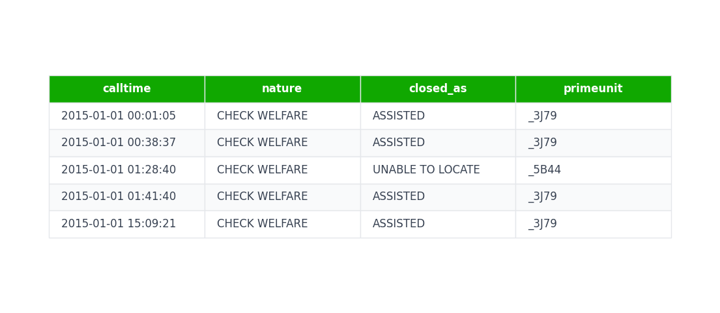
Data
Note: All data provided is public and was provided by Rori Rohlfs
Computer-Aided Dispatch (Eugene) + Springfield 911 Call Data
Time of dispatch
Nature of call
How it ended
Who responded
Springfield Call Outcome Data
Sample entries of dataset

Slide 9
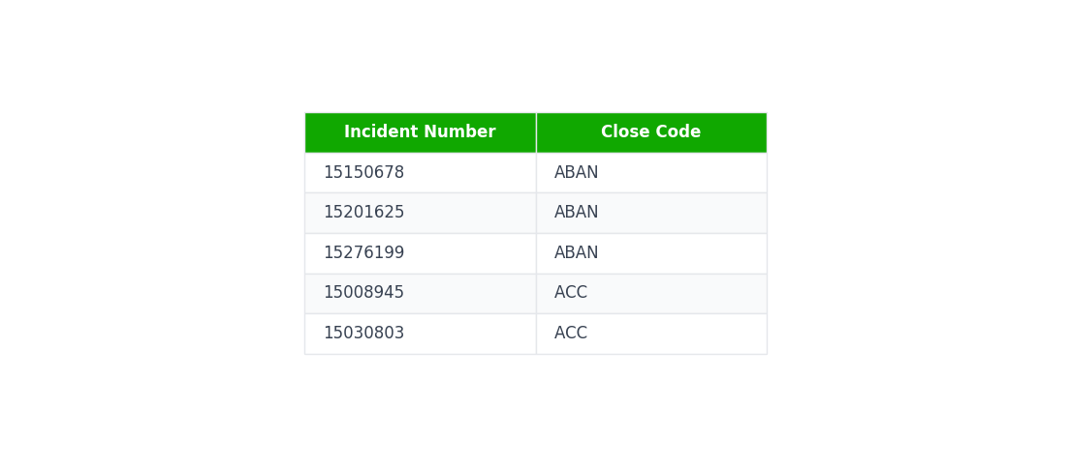
Data
Note: All data provided is public and was provided by Rori Rohlfs
Springfield Call Outcome Data
Contains close codes used in Springfield 911 Call Data
Was used to find the outcome of calls from Springfield 911 Call Data
Computer Aided Dispatch (Eugene)
&
Springfield 911 Call Data
Springfield 911 Call Data
Sample entries of dataset

Slide 10
Methodology
How did I use this data to address my research questions?

Slide 11
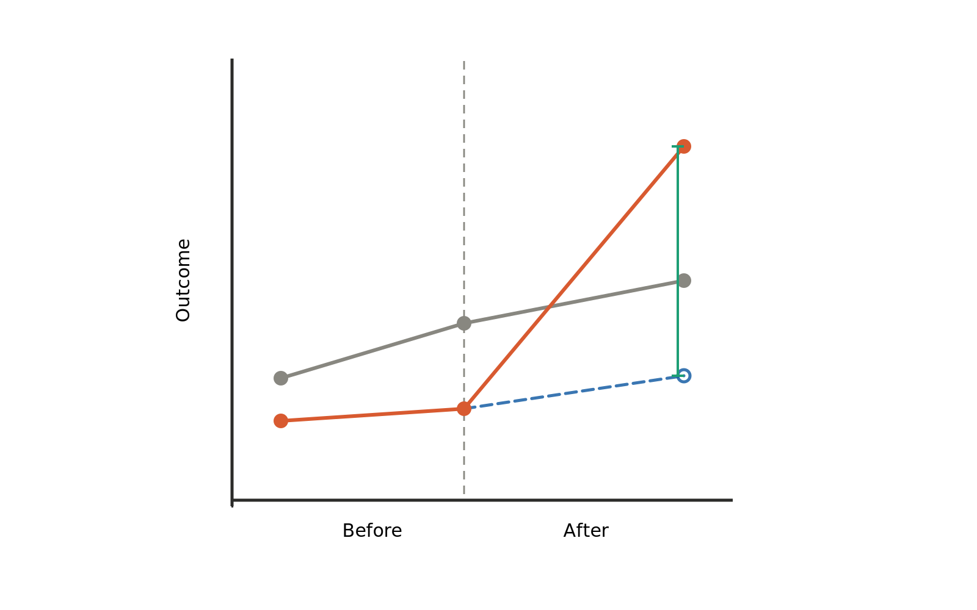
Difference in Differences
We have two comparable groups
Eugene – No CAHOOTS (treatment group)
Springfield – Has CAHOOTS (control group)
What do we learn?
Impact of CAHOOTS being defunded on:
Volume of welfare checks
Volume of arrest outcomes
An example of a difference-in-differences plot

Slide 12
An example of a difference-in-differences plot

Slide 13
Control Group
[Springfield]
An example of a difference-in-differences plot

Slide 14
Treatment Group
[Eugene]
Control Group
[Springfield]
An example of a difference-in-differences plot

Slide 15
Treatment Given
[CAHOOTS defunded]
Treatment Group
[Eugene]
Control Group
[Springfield]
An example of a difference-in-differences plot

Slide 16
Treatment Given
[CAHOOTS defunded]
Treatment Group
[Eugene]
Control Group
[Springfield]
Counterfactual
[Expectation if CAHOOTS still operating]
An example of a difference-in-differences plot

Slide 17
Treatment Given
[CAHOOTS defunded]
Treatment Group
[Eugene]
Effect of Treatment
[Impact of CAHOOTS being defunded]
Control Group
[Springfield]
Counterfactual
[Expectation if CAHOOTS still operating]
An example of a difference-in-differences plot

Slide 18
Results
What did I find from the data?

Slide 19
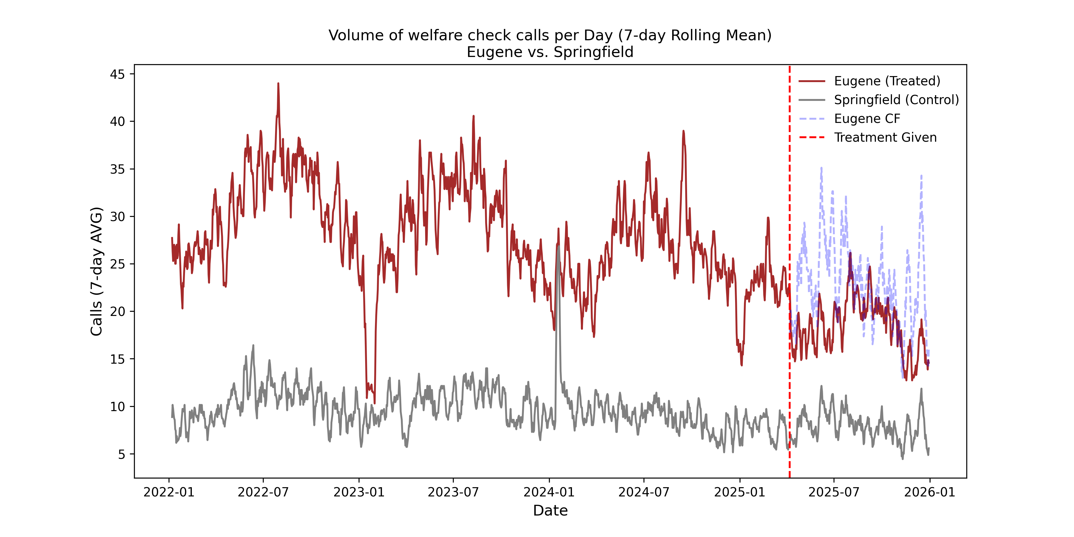
Eugene volume of welfare check fell after CAHOOTS was defunded

Slide 20
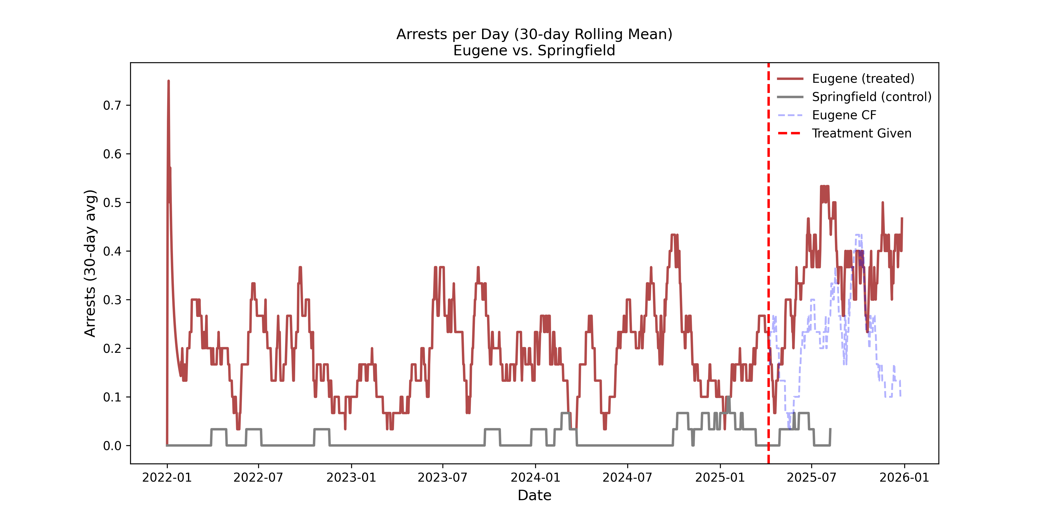
Arrests concluding welfare checks increased post-CAHOOTS in Eugene

Slide 21
So what?
What can we do?

Slide 22
Discussion – Recommendations
Bringing law enforcement up to CAHOOTS' standard

Slide 23

Discussion – Recommendations
Bringing law enforcement up to CAHOOTS' standard
Restoring CAHOOTS and bring it back into operation

Slide 24
Limitations
All research has its limitations

Slide 25

Discussion – Limitations
Lack of data after CAHOOTS was defunded

Slide 26

Discussion – Limitations
Lack of data after CAHOOTS was defunded
Recommendations suggest theoretical approaches that may be unrealistic

Slide 27
Questions

Slide 28
Acknowledgements
Special thanks to these wonderful people!
Rori Rohlfs
Eli Andrae
Jennifer Linnaea
Alex Gollier
Marco Montemore
Diego Lopez

